Slide 1

E-commerce WINKLE
Task - 2

Slide 2

E-commerce WINKLE
"Winkle is a dynamic e-commerce platform, reimagining online shopping for a global audience. With an extensive product catalog, seamless transactions, and a vibrant community, Winkle connects buyers and sellers in a user-friendly digital marketplace, making every purchase an experience."
▪
LMS Username
Name
Batch
au111420205014
HEPZIBAH CATHERINE F
CA10
au111420205036
RISHIKESH R
CA10
au111420205048
TAMILSELVAN V
CA10
au111420205055
YUVARAJ B
CA10

Slide 3

Task-2
Create UI and implement various components using react
●
●
●
Split design into components and Higher order Components
Define structure of the components
Set the basic ui components with dummy data
Integrate the APIs to frontend to ensure the dynamic feature of website
Point base api to the severs base url
Design api calls for each element
Handle errors in the output
Render output of apis to different low level components
Secure content of post apisx
●
●
●
●
●
Evaluation Metric:
100% Completion of the above tasks
Learning Outcome
▪
▪
▪
▪
Developing complicated UI using react components
Using props drilling and context to pass variables
Getting familiar with different type of api calls
Handling different input data

Slide 4

Step-Wise Description
Key Features:
Highlight Features: "Explore an extensive product catalog, enjoy secure transactions, and become part of a vibrant community that makes Winkle more than just a shopping platform—it's an experience.
User-Centric Approach:
User Focus: "Driven by a user-centric approach, Winkle aims to make online shopping intuitive, enjoyable, and accessible for individuals, businesses, and organizations alike."
Innovation and Diversity:
Innovative Hub: "Embrace innovation and diversity with Winkle, where creativity flourishes through various content formats—text, images, and videos—creating a unique space for every user."
Global Connection:
Global Marketplace: "Winkle is not just a platform; it's a global marketplace that transcends geographical boundaries, connecting people from different corners of the world through a shared love for discovery and commerce."
Empowering Sellers:
Seller Empowerment: "For sellers, Winkle offers a powerful platform to showcase products, reach a global audience effortlessly, and become part of a thriving ecosystem that supports entrepreneurship."

Slide 5
Summary of your task
Certainly! The task involved creating an introductory overview for the "Winkle" e-commerce platform. The summary includes a concise project introduction, motivation behind creating Winkle, and a brief overview of its purpose. Additionally, a step-wise description was provided to ensure a structured and engaging introduction, covering key aspects such as user focus, innovation, global connectivity, and seller empowerment. The goal is to communicate Winkle's unique value proposition as an inclusive, secure, and community-driven e-commerce destination.

Slide 6
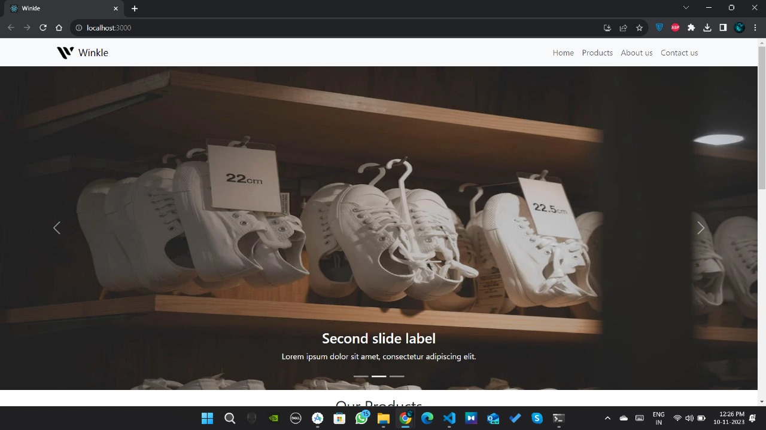

Slide 7
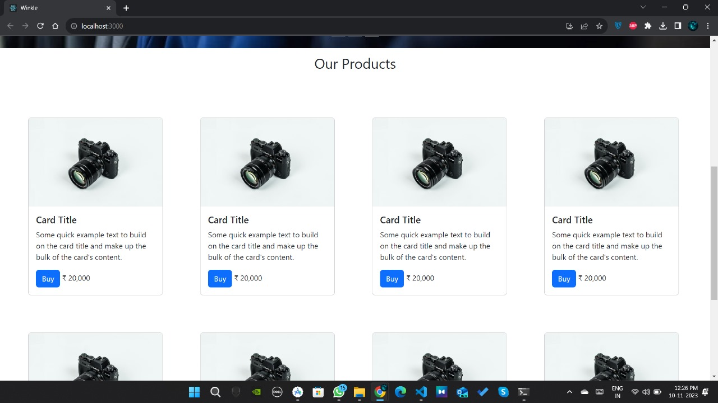

Slide 8

Submission Github
https://github.com/Rishi963/Naanmudhalvan-FSD-PEC-CA10

Slide 9


